Slide 1




Consumer Goods
AD-Hoc Insights
Presented By : Kritika singh

Slide 2




Content
1. Company Overview
Problem Statement
Datasets and model
4. Ad-hoc requests , output and insight
5. Recommendations

Slide 3


Company Overview
Atliq Hardwares (imaginary company) is one of the leading computer hardware producers in India and well expanded in other countries too.

Slide 4
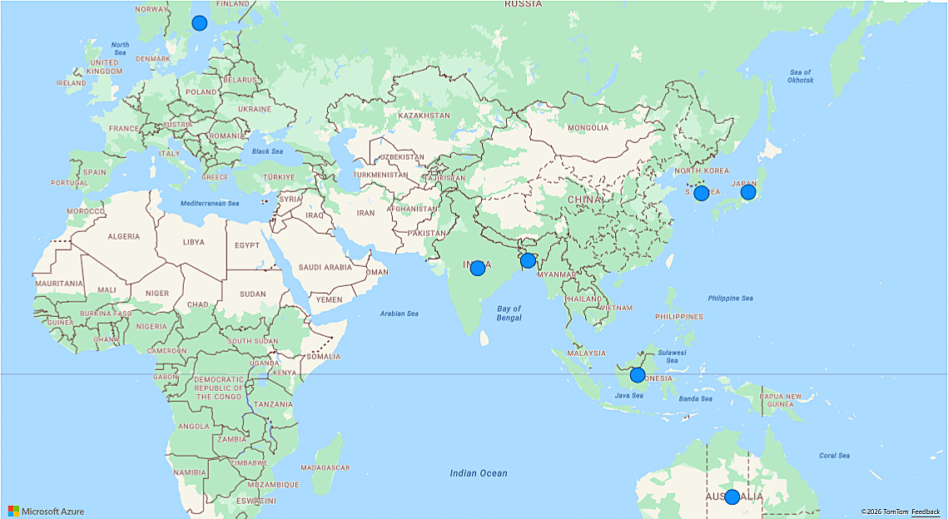
Markets
.

Slide 5
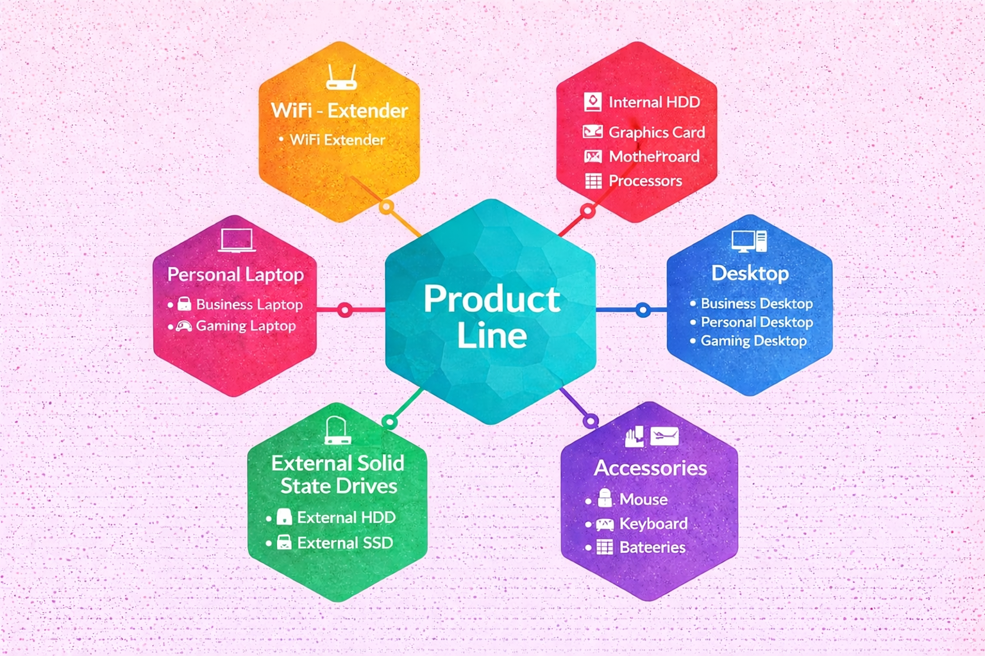
Products
.

Slide 6

Problem Statement
Management noticed a lack of insights for quick , smart data-informed decisions.
Decision made to expand the data analytics team with several junior data analysts.
Tont Sharma , the data analytics directors ,seek candidates with strong tech and soft skill.
To evaluate these skill ,Tony decided to conducts a SQL challenge.
.

Slide 7
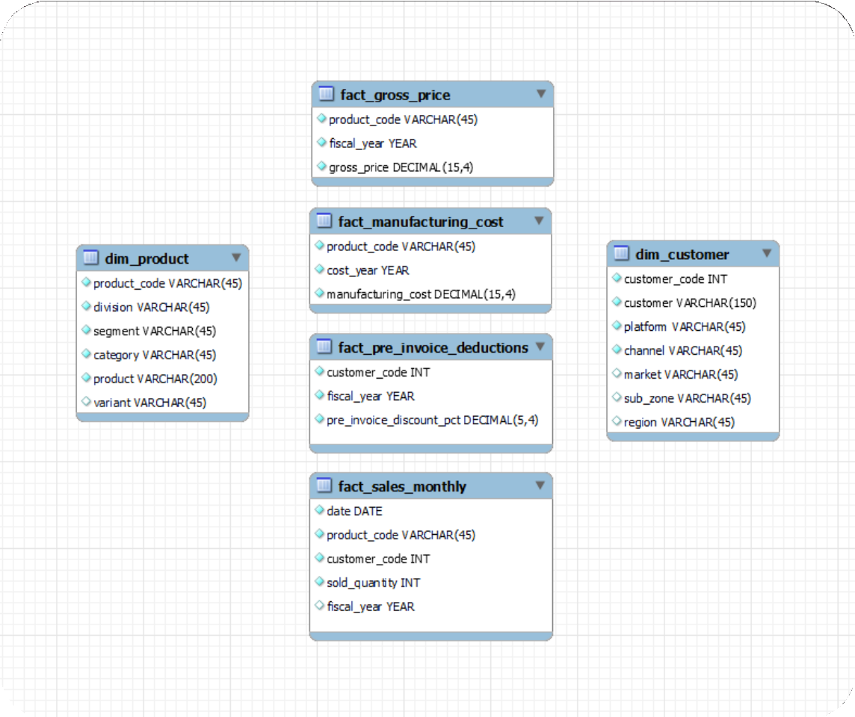
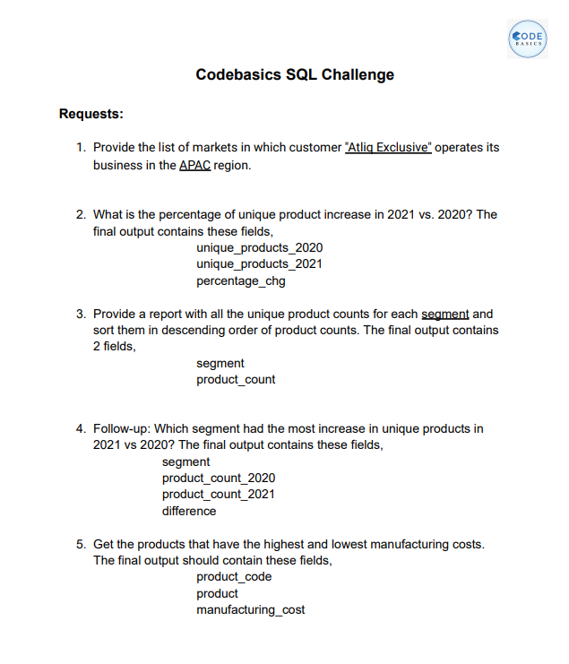
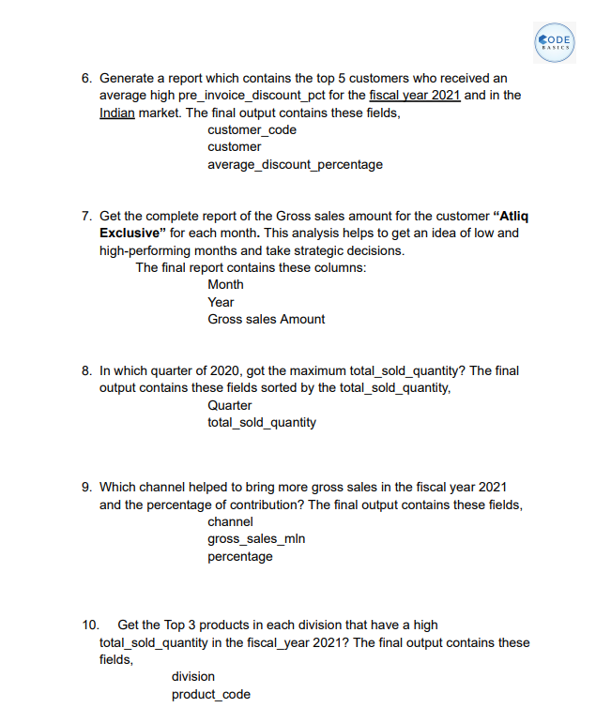

Datasets
.

Slide 8
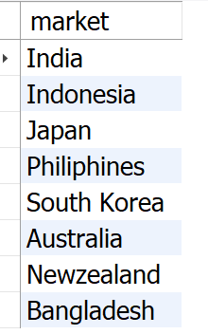
Provide the list of markets in which customer "AtliQ Exclusive" operates its business in the APAC
region.
“select”
distinct market
from dim__customer
where customer = “AtliQ exclusive”
and
region =“APAC”
Request - 1
INPUT
Output
.

Slide 9
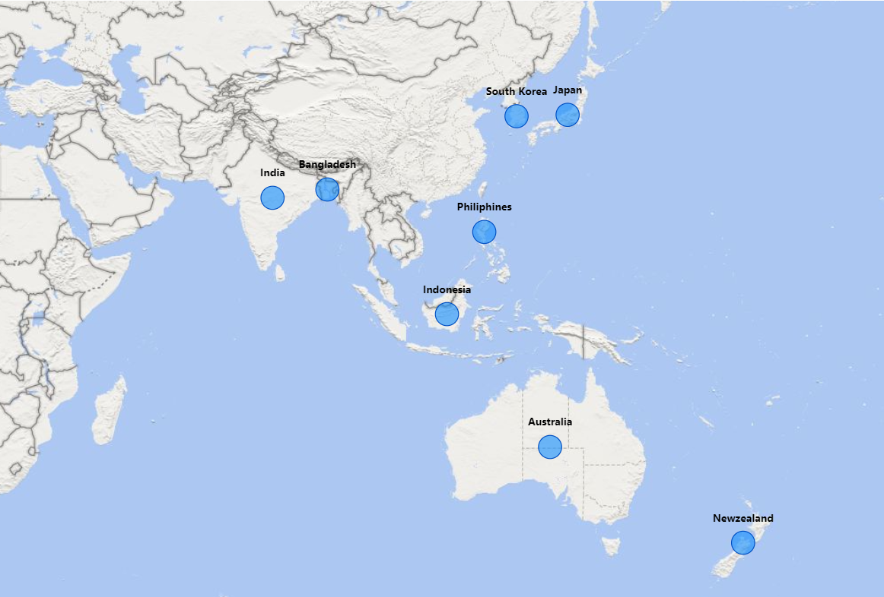
Conversion Of Output To Input Visuals And Insights
.
Our “AtliQ Exclusive” has expanded its reach to 8 strategic markets in the APAC region.

Slide 10
what is the percentage of unique products increase in 2021 vs 2020? The final output
these fields , unique_products_2020, unique_products_2021 , percentage_chg.
with cte1 as (
select count(distinct product_code) as unique_products_2020
from fact_Sales_monthly
where fiscal_year =2020
),
cte2 as (
select_count(distinct product_code) as unique_products_2021
from fact_Sales_monthly
where fiscal_year =2021
)
select
unique_product_2020,
unique_product_2021,
(unique product_2021-unique product_2020)*100/unique_product_2020
as pct_change
from cte1
cross join cte2
;
Request – 2.
INPUT
.

Slide 11
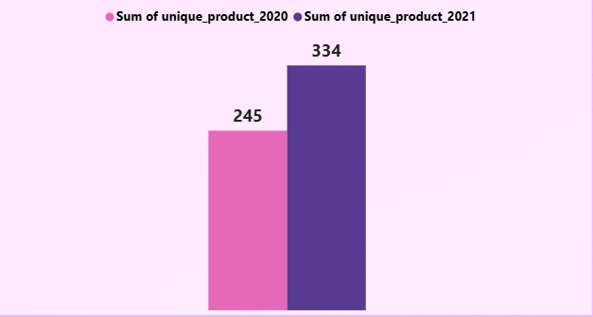
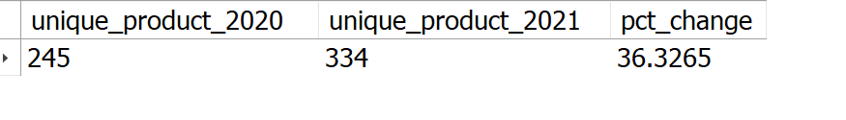
Output
36%
.
Our focus on innovation has fueled steady product growth, with the portfolio rising from 245 products in FY 2020 to 334 in FY 2021—a significant 36% increase..

Slide 12
Provide a report with all the unique product counts for each segment and sort them
in descending order of product counts . The final output contains 2 fields,
segments,porducts_count.
“select”
segment ,
count(distinct product_code) as product_count
from dim_product
group by segment
order by product_count desc
;
Request – 3.
INPUT
.

Slide 13
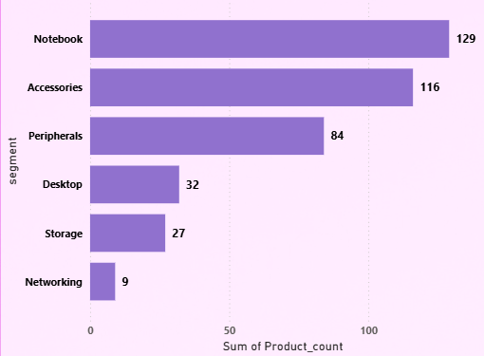
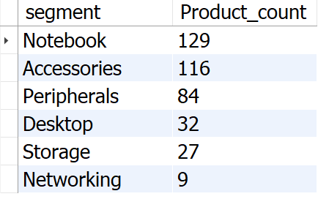
Output
Segments such as notebooks, accessories, and peripherals are experiencing notable manufacturing expansion when contrasted with desktops, storage, and networking.
Notebooks, accessories, and peripherals make up 83% of the total manufactured products.

Slide 14
Follow up : which segment had the most increase in unique products in 2021 vs 2020 ? The final
output contains these fields ,segment , product_count_2020 ,product_count_2021 ,difference.
with unique_products as (
select
p.segment,
count(distinct(case when fiscal_year = 2020 then s.product_code end) as product_count_2020,
count(distinct(case when fiscal_year = 2021 then s.product_code end) as product_count_2021,
from fact_sales_monthly s
join dim_products p
on s.product_code = p,product_code
group by p.segment
)
select
*,
product_count_2021 –product_count_as difference
from unique_products
order by difference desc
;
Request – 4 .
INPUT

Slide 15
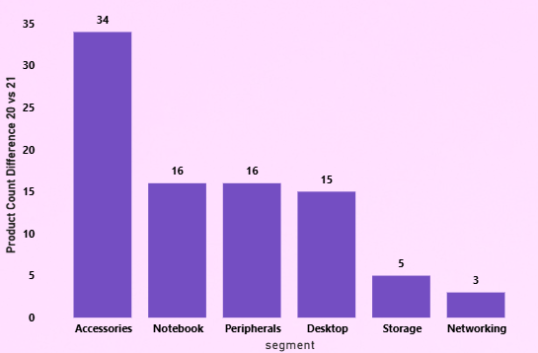
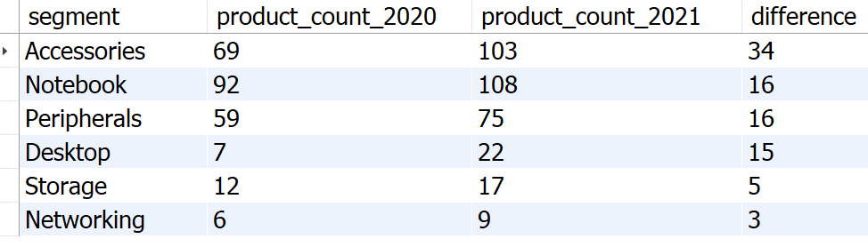
Output
.
Accessories saw the most significant rise in production.
Storage and networking are undergoing slower growth compared to other segments

Slide 16

Get the products that have the highest and lowest manufacturing costs.The final output
should contain these fields , product_code, product ,manufacturing_cost.
(select
p.product_code,
p.product ,
m.manufacturing_cost
from dim_product p
join fact_manufacturing_cost m
on p.product_code = m.product_code
order by m.manufacturing_cost desc
limit 1)
union
(select
p.product_code,
p.product ,
m.manufacturing_cost
from dim_product p
join fact_manufacturing_cost m
on p.product_code = m.product_code
order by m.manufacturing_cost desc
limit 1)
;
Request – 5 .
INPUT

Slide 17
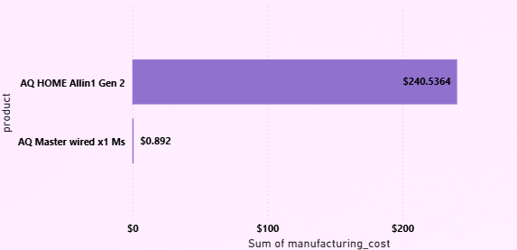
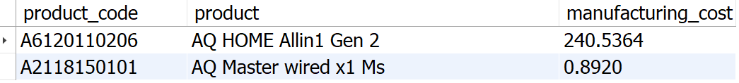
Output
The AQ Home Allin1 Gen2 (Variant: Plus 3)
Personal desktop has the highest manufacturing cost.
The AQ Master wired x1 Ms (Variant: Standard 1)
Mouse incurs the lowest manufacturing cost.

Slide 18
Generate a report which contain the top 5 customers who received an average high
pre_invoice_discount_pct for the fiscal year 2021 and in the Indian market. The output
contains these fields, customer_code,customer, average_discount_percentage.
with cte1 as(
select
*
from fact_pre_invoice_deductions
join dim_customer c
using(customer_code)
where fiscal_year = 2021
and c.market =“india”
)
select
customer_code,
customer,
concat(round(avg(pre_invoice_discount_pct)*100,2),”%”) as avg_discount –pct
from cte1
group by customer_code,customer
order by avg(pre_invoice_discount_pct)*100 desc
limit 5 ;
Request – 6 .
INPUT

Slide 19
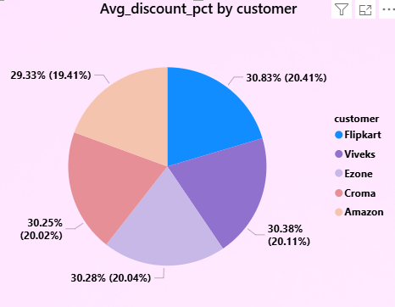
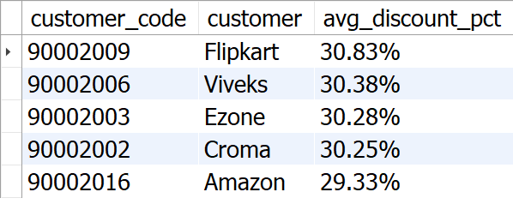
Output
Flipkart received the highest average pre-invoice discount.
Amazon received the lowest average pre-invoice discount.

Slide 20
Get the complete report of the Gross sales amount for the customer “AtliQ Exclusive” for each month.
This analysis helps to get an idea of low and high-performing months and take strategic decisions. The
final report contains these columns: Month, Year, Gross sales Amount.
Select monthname(s.date) as Month , s.fiscal_year as Year, sum(sold_quantity*gross_price) as Gross_sales from fact_sales_monthly s join fact_gross_price g on s.product_code = g.product_code join dim_customer c on s.customer_code = c.customer_code where customer = "AtliQ Exclusive“ group by month,year order by year asc ;
.
Request – 7 .
INPUT

Slide 21
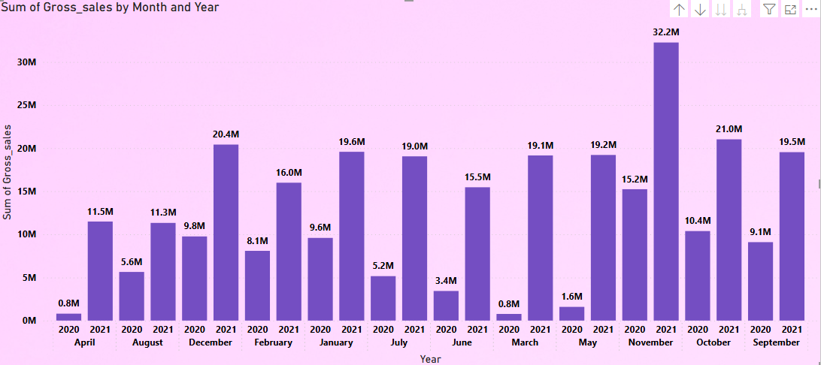
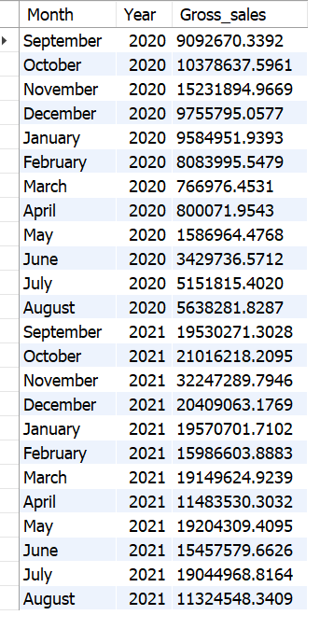
Output
1. March, April, May recorded the lowest sales in 2020, likely due to the COVID-19 pandemic. Sales began to recover after June 2020.
2. November generated the highest sales for 2020, with around 15.23 million.
3. Sales figures in 2021 show significant growth compared to 2020.
4. In 2021, the lowest sales were in August, accounting for 11.32 million, while the highest sales were in November, reaching 32.25 million.

Slide 22
select
case
when month (date) in (9,10,11) then “Q1”
when month (date) in (12,1,2) then “Q2”
when month (date) in (3,4,5) then “Q3”
when month (date) in (6,7,8) then “Q4”
end ) as Quarter,
sum(sold_quantity) as total_Sold_qty
from fact_sales_monthly
where fiscal_year = 2020
group by Quarter
order by total_sold_qty desc
;
Request – 8 .
In which quarter of 2020, got the maximum total_sold_quantity? The final output contains these fields sorted by the total_sold_quantity , Quarter, total_sold_quantity

Slide 23
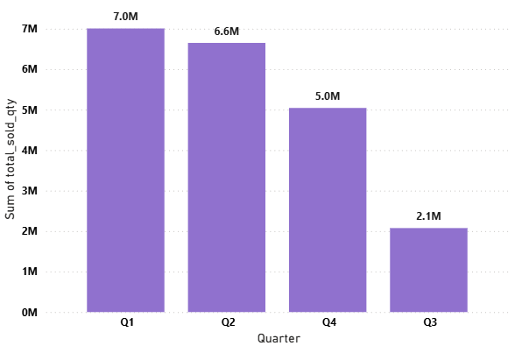
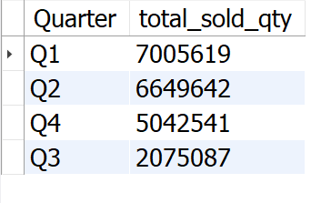
Output
The highest number of units sold across all quarters occurred in Quarter 1 of FY 2020, whereas Quarter 3 recorded the lowest sales.
Approximately 34% of the total quantity sold in FY 2020 is attributed to Quarter 1.

Slide 24
which channel helped to bring more gross sales in the fiscal year 2021 and the percentage of
contribution ? The final output contain these fields , channel , gross_sales_mln , percentage.
with cte1 as(
select
c.channel,
round(sum(s.sold_quantity*gross_price)/1000000),2) as gross_sales_mln
from dim_customer c
join fact_Sales_monthly s
on c.customer_code = s.customer_code
join fact_gross_price g
on s.product_code = g.product_code
where s.fiscal_year = 2021
group by channel
)
select *
conact(round(gross_Sales_mln*100/(select sum(gross_sales_mln)from cte1),2),”%”) as pct_contribution
from cte1
order by pct_contribution desc ;
Request –9.

Slide 25
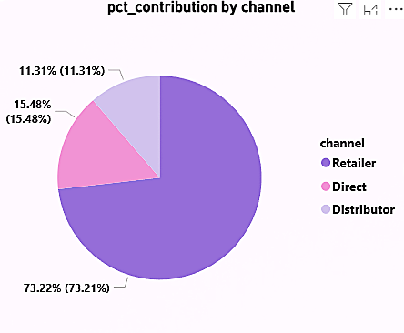
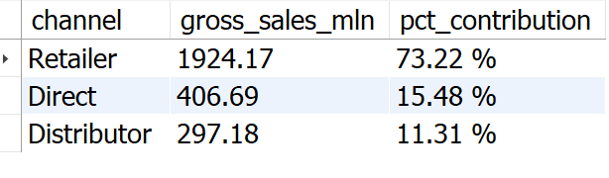
Output
Most of our sales occurred through Retailer, constituting 75% of the overall sales. Only a minimal portion of our sales occurred directly and via distributor channels.

Slide 26
Get the top 3 product in each division that have a high total_sold_quantity in the fiscal_year 2021?
The final output contains these field, division product_code, product total_Sold _quantity rank order
with cte1 as(
select
p.division,
s.product_code,
concat(p.product,”(“,p.variant,”) as product,
sum(s.sold_quamtity) as total_sold_qty,
rank () over(partition by p.division order by sum(s.sold_quantity) desc) as rank_order
from dim_product p
join fact_Sales_monthly p
on p. product_code = s.product_code
where fiscal_year = 2021
group by p.division ,s.product_code,p.product
)
select*,
from cte1
where rank_order in(1,2,3)
order by division,rank_order asc;
Request – 10.

Slide 27
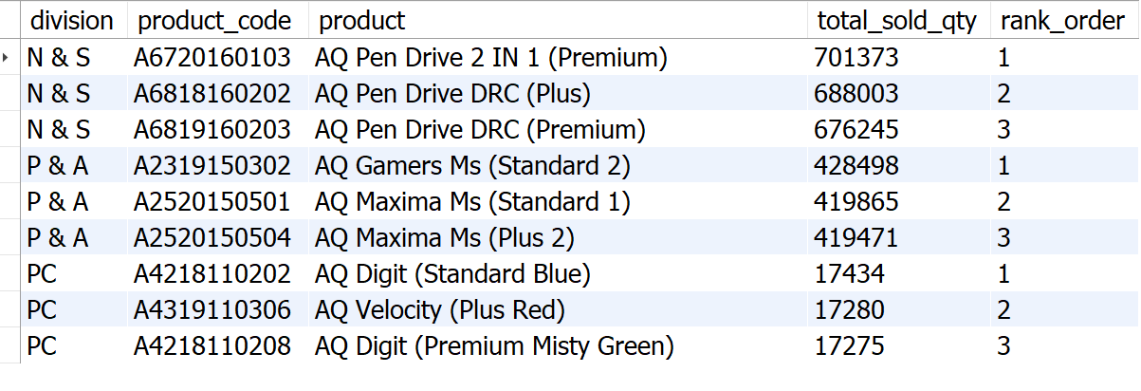
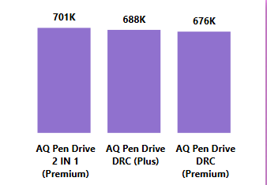
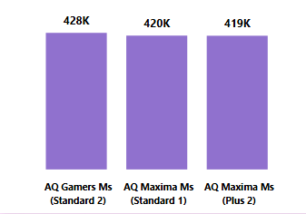
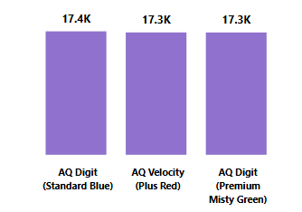
Division N & S Division P & A Division PC
Output
The leading three products in N & S were Pen drives, with a total quantity sold of approximately 700,000 units.
The leading three products in P & A were Mouse, with a total quantity sold of approximately 400,000 units.
The leading three products in P & C were Personal Laptops, with a total quantity sold of approximately 17,000 units.

Slide 28
Recommendation
1. Focus on desktops, Storage, and Networking segment. 2. Emphasizes multi-channel marketing. 3. Combine pricing strategies with attractive promotions. 4. Continuously improve based on customer feedback. 5. Invest in sales team training for improved performance.

Slide 29

THANK YOU

